Slide 1
Sleep and Fatigue: How to get a good night’s rest (and feel more awake during the day) with Parkinson’s disease
Rebecca Gilbert, MD, PhD
Chief Scientific Officer,
American Parkinson disease association

Slide 2
outline
Why is sleep important in PD?
Why is sleep affected in PD?
How is sleep impacted in PD:
Sleep disorders associated with PD
Sleep disorders that result from PD medications
Common PD symptoms that impact sleep
Fatigue and excessive daytime sleepiness (EDS) in PD

Slide 3

Why is sleep important in PD
When you don’t get a good night’s sleep….
Worse motor symptoms
Worse cognition
Poor sleep → daytime sleepiness → naps → poor sleep
Notes:
Intuitively obvious that poor sleep leads to a whole host of complications

Slide 4
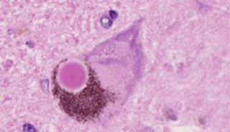
Why is sleep affected in PD?
Lewy bodies can be found throughout the brain in PD, including in brain areas that control sleep and wakefulness
A Lewy body
Notes:
As you may be aware, the pathologic hallmark of PD is the Lewy body which is the pink circle in the middle of this nerve cell. Lewy bodies are an abnormal accumulation of the protein alpha-synuclein and is thought by many to be a key element responsible for nerve death in PD. Lewy bodies are found in the dopamine neurons which when affected cause the movement problems of PD, but they can also be found in many other areas in the brain, including the sleep areas of the brain. This is thought to be responsible for the sleep problems of PD

Slide 5
Sleep disorders associated with Parkinson’s disease
Many different sleep disorders can be associated with Parkinson’s disease:
Rapid eye movement (REM) behavior sleep disorder
Insomnia
Primary
Secondary
Sleep fragmentation
Restless leg syndrome
Sleep apnea
Notes:
So what are the potential sleep disorders that are associated with PD?

Slide 6
Evaluating Sleep
Sleep study, also called polysomnography
Can be done at a sleep center or at home
Records activity of the body during sleep
brain waves
oxygen levels in the blood
heart rate
breathing
eye movements
leg movements
Notes:
If sleep is difficult for you, your doctor may consider getting you a sleep study to evaluate your sleep.

Slide 7
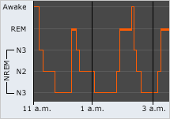
Stages of sleep
1
p
healthysleep.med.harvard.edu
Notes:
Let’s start with a discussion of one of the most common sleep disorders of PD – REM behavior sleep disorder.
To understand this disorder, we need to discuss the stages of sleep.
There are two basic types of sleep – rapid eye movement or REM sleep and non-rapid eye movement, or non-REM sleep. Non-REM sleep is in turn divided into three stages – stage 1, stage 2, stage 3. You cycle through these types of sleep every approx. 1.5 hours through the night.
REM sleep typically occurs for the first time about 90 minutes after falling asleep. Your eyes move rapidly behind closed eyelids. This is when dreaming occurs.

Slide 8

REM behavior sleep disorder
Normally, people are paralyzed during REM sleep
In REM behavior sleep disorder, a person is not paralyzed and can act out his/her dreams
This can cause injury to the person and bed partner
Treatments
Modify sleep environment
Melatonin
Clonazepam

Slide 9
REM behavior sleep disorder
Can be a part of pre-motor Parkinson’s disease – a set of non-motor symptoms that can precede a diagnosis of Parkinson’s disease
Pre-motor PD can include: REM behavior sleep disorder, poor smell, constipation and depression

Slide 10
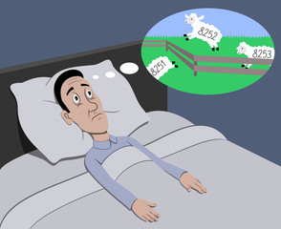
Insomnia
Primary insomnia – difficulty falling asleep at the start of the night
Secondary insomnia – difficulty falling asleep after waking up during the night

Slide 11
Insomnia
Solutions:
Improve sleep hygiene
Turn off screens
Make bedroom only for sleep
Avoid eating or exercising close to bedtime
Cognitive behavioral therapy
Review medications
Treat depression
Melatonin
Referral to sleep specialist
Notes:
There are numerous medications on the market designed to induce sleep. These medications may be appropriate for those with primary or secondary insomnia associated with PD. However, medications that induce sleep can have unwanted side effects such as gait instability or reduced mental clarity, so these medications need to be chosen carefully. A referral to a sleep specialist may be warranted in someone with persistent insomnia.

Slide 12

Sleep fragmentation
Brief arousals occurring during a period of sleep
Can lead to poor sleep quality, decreased restfulness, and excessive daytime sleepiness
The person may not be aware that he/she is having arousals and they may be only seen on a sleep study

Slide 13
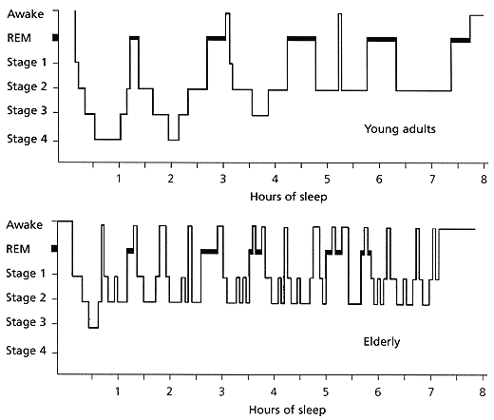
Sleep fragmentation
American Family Physician. 1999. 59(9): 2551-2558
Notes:
As we age, the sleep cycle shortens and there are more arousals throughout the night. This becomes even more of a problem in Parkinson’s disease

Slide 14
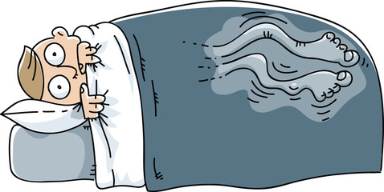
Restless leg syndrome
An uncomfortable sensation in the legs (and sometimes in the arms)
Temporarily relieved by movement
Described as crawling, electric, itching, aching etc.
Occurs in the evening and night and can prevent or interrupt sleep
Can be an independent disorder, not associated with PD
Can be associated with damage to the nerves in the hands and feet (peripheral neuropathy) as well as iron deficiency.

Slide 15
Restless leg syndrome
No specific studies have been done for RLS in PD
Treatments for RLS (not specifically associated with PD) include:
Dopamine agonists
Levodopa
Gabapentin, gabapentin enacarbil, pregabalin

Slide 16
sleep apnea
A sleep disorder in which breathing stops and starts through the night. This leads to periods of low oxygenation in the blood and frequent awakenings
Parkinson’s disease may be associated with both types of sleep apnea
Central - decreased drive to breathe in sleep due to brain stem lesion
Obstructive – abnormal function in the muscles of the upper airway
Diagnosis via sleep study (at home or in clinic)
Untreated sleep apnea can raise the risk of heart disease and stroke, and can cause depression, poor memory, headaches

Slide 17

sleep apnea
Elevate head of bed
Oral appliance (good for obstructive sleep apnea)
Non-invasive ventilation
CPAP
Continuous Positive Airway Pressure
Same pressure during inhalation and exhalation
BiPAP
Bilevel Positive Airway Pressure
Pressures are different between inhalation and exhalation

Slide 18


Sleep disorders that result from PD medications
Vivid dreams/nightmares
Sleep attacks – falling asleep without warning

Slide 19

NON-Motor symptoms of Parkinson’s DIsease
Motor symptoms
Tremor, slowness, stiffness, postural instability
Non motor symptoms
NEUROPSYCHIATRIC
Depression
Anxiety
Hallucinations/psychosis
Cognitive impairment and dementia
Apathy
AUTONOMIC & VISCERAL
Orthostatic hypotension
Constipation
Speech and swallow difficulties
Urinary dysfunction
Sexual dysfunction
SENSORY
Visual disturbances
Loss of smell
Pain
Notes:
As you are aware, Parkinson’s disease symptoms are divided into motor symptoms – the ones that affect movement – tremor, slowness, stiffness, balance problems – as well as non-motor symptoms, the ones that do not affect movement. There are a number of PD symptoms, both motor and non-motor that can affect sleep. I have highlighted there in yellow

Slide 20

Pd symptoms that impact sleep – anxiety
Worrisome thoughts and anxiety keep a person with PD from falling asleep at the start of the night or from falling back asleep upon awakening during the night
Treatments:
Lifestyle modifications
Exercise
Meditation
Cognitive behavioral therapy
Medications
Selective serotonin reuptake inhibitors (SSRIs)
Selective serotonin and norepinephrine reuptake inhibitors (SNRIs)

Slide 21



Pd symptoms that impact sleep – hallucinations
Common hallucinations in PD: furry animals, babies, dead relatives
A person can wake up to a hallucination which makes it very difficult to return to sleep.

Slide 22
Pd symptoms that impact sleep – urinary symptoms
Urinary symptoms that can interrupt sleep
Urinary urgency
Urinary frequency
Nocturia with frequent awakenings to urinate
Urinary dribbling or incontinence
Treatment
Assessment for other causes of urinary issues (e.g. enlarged prostate)
Urinary issues of PD can be treated with medications, but be sure to use medications with fewer cognitive side effects
Mirabegron
Trospium
Solifenacin
Darifenacin
Botulinum toxin injections

Slide 23
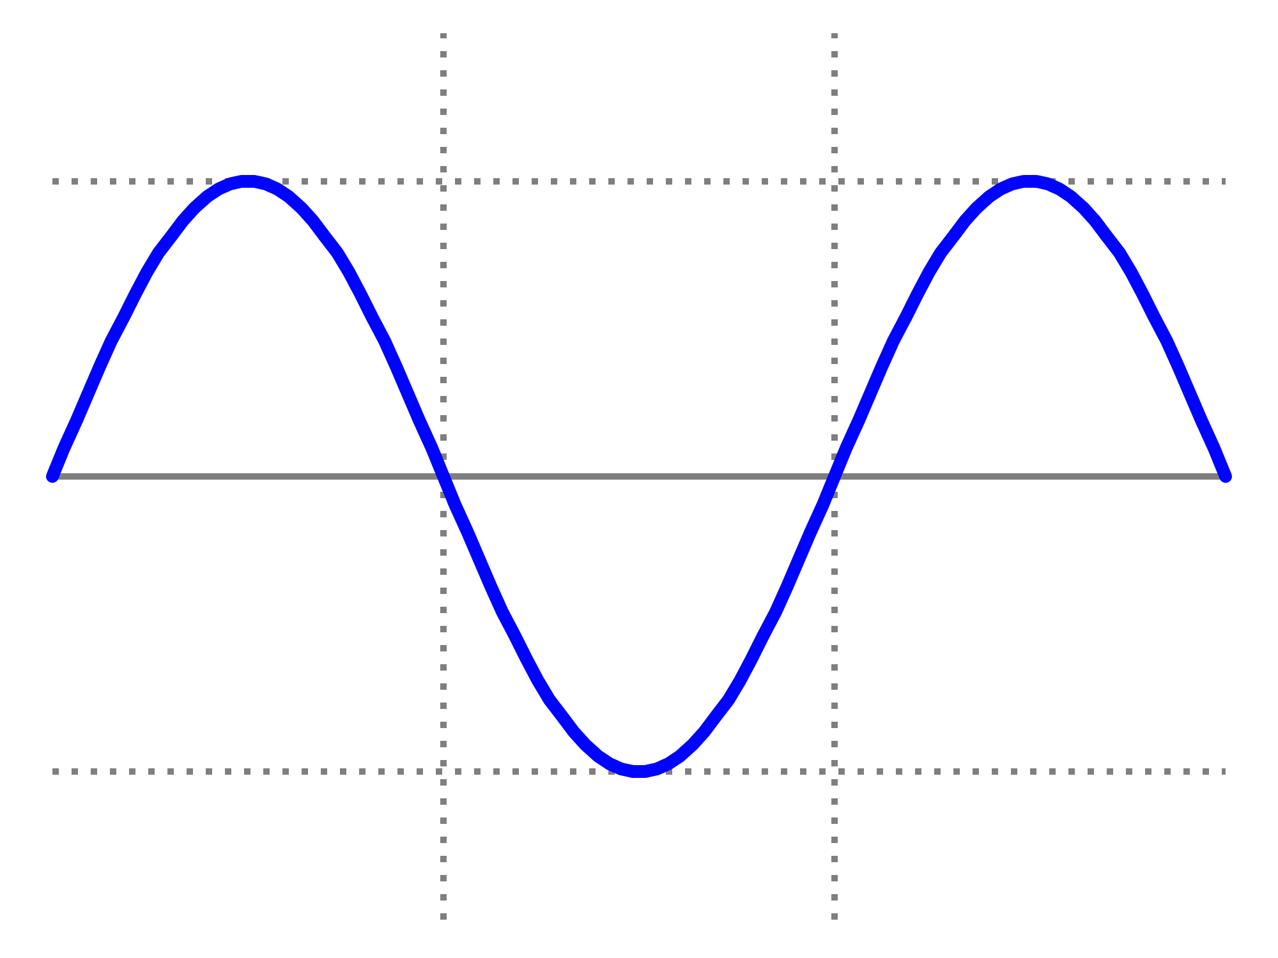
Pd symptoms that impact sleep – motor symptoms
ON
ON
Clinical Response
OFF
dose
dose
Time
Motor symptoms such as tremor and stiffness can impact sleep
Notes:
The symptoms of PD can fluctuate throughout the day and night depending on the time from the last dose of medication. Typically, a person takes a dose of medication and experiences a clinical improvement – motor symptoms improve and there is typically less tremor, stiffness and slowness. This is referred to as ON time. However, as time from the last dose lengthens, symptoms can return. This is referred to as OFF time.
If the last dose is before bed, then a person may wake up in the middle of the night with the return of their PD symptoms. These symptoms could be tremor or stiffness and could impact a person’s ability to get back to sleep.

Slide 24
Levodopa formulations
Drug | Formulation | Brand Name
Carbidopa / Levodopa | Immediate release (IR) | Sinemet®
Carbidopa / Levodopa | Extended release (ER) | [N/A - generic only]
Carbidopa / Levodopa | Extended release capsules (ER) | Rytary®
Carbidopa / Levodopa | Intestinal gel | Duopa®
Notes:
Here is a table of some of the levodopa formulations that are available that treat PD motor symptoms.
The standard formulation is carbidopa/levodopa immediate release which is also frequently referred to by its brand name Sinemet.
There are other formulations that can provide more continuous drug delivery and these may be used to provide symptom relief through the night.

Slide 25

Fatigue in Parkinson’s disease
Poor sleep
Medication side effect
Other medical condition (e.g. thyroid imbalance or anemia)
Depression
Part of PD - Neurodegeneration in areas of brainstem that are responsible for maintaining wakefulness
Notes:
Let’s now focus on the flipside of trouble sleeping – which is trouble with level of alertness or maintaining wakefulness during the day.
We will discuss two related but distinct symptoms – fatigue and excessive daytime sleepiness.
Let’s start with fatigue.
Many people with PD describe fatigue as more encompassing that simply being tired. They will use words such as run down or out of energy. Some will report that sleep is not refreshing and does not relieve fatigue.
There are many reasons why fatigue might be occurring:
The first is poor sleep for all the reasons that we discussed up until now – perhaps there is poor sleep hygiene, or a PD related sleep disorder, or a sleep disorder from PD meds, or a PD symptom that is interrupting sleep. Remember there are some sleep disorders, for example sleep fragmentation, in which the person themselves may think they are getting uninterrupted sleep, but they are not.
Medication – PD medications themselves can frequently cause fatigue
Medical issue, depression,
It is also possible that a sleep study does not reveal a problem, there is no medication, medical issue or depression contributing to fatigue, yet the person still feels this lack of energy. This is something that we do not fully understand, but could be due to neurodegeneration in areas of the brain that maintain wakefulness

Slide 26

Excessive daytime sleepiness
Defined as an inability to maintain wakefulness during the waking day
Excessive daytime sleepiness increases in prevalence as PD advances
Notes:
Another common non-motor symptom related to wakefulness is excessive daytime sleepiness or an inability to maintain wakefulness during the waking day which leads to lapses into drowsiness or sleep
For both fatigue and EDS a similar set of causes need to be considered – poor sleep at night (for all the reasons that we had previously discussed), medication effect, other medical causes, depression. If any of these causes are revealed, treatment can be directed at it.

Slide 27

strategies that improve wakefulness during the day
Encourage daily exercise and activities
Light therapy
Medications
Modafinil
Methylphenidate
Caffeine
Istradefylline
Notes:
Trying strategies that improve wakefulness during the day
Non-pharmacologic interventions
Encouraging daily exercise and activities – a person without an activity planned is much more likely to dose than one who is engaged in an activity. Be realistic about scheduling a person with advanced PD, but aim for at least one scheduled activity a day
Light therapy – Light therapy, in which a person is exposed to bright light via a light box, is used as a treatment modality for sleep disorders and psychiatric disorders not associated with PD. A small clinical trial testing its efficacy in PD was conducted and demonstrated an improvement in sleep and in excessive daytime sleepiness.
Pharmacologic interventions
There are no FDA approved medications for EDS in the context of PD. However, clinicians sometimes prescribe medication off-label for EDS. These include modafinil, methylphenidate, and caffeine. Istradefylline is a medication approved to treat motor symptoms of PD. A small trial demonstrated potential improvement of EDS as well. Talk with your physician about the possibility of using a medication to maintain wakefulness during the day.

Slide 28
summary
Sleep disorders associated with PD
Rapid eye movement (REM) behavior sleep disorder
Insomnia
Sleep fragmentation
Restless leg syndrome
Sleep apnea
Sleep disorders that result from PD medications
Sleep attacks
Vivid dreams
Common PD symptoms that impact sleep
Hallucinations
Anxiety
Urinary problems
Motor OFF time at night
Fatigue and Excessive Daytime Sleepiness

Slide 29



American Parkinson disease association
Every day, we provide the support, education, and research that will help everyone impacted by Parkinson’s disease live life to the fullest.
Toll-free: 800-223-2732
apdaparkinson.org
@apda.inc
@APDAparkinsons
@apdaparkinsons

