Slide 1
PD Research Update
Joel S Perlmutter
Elliot Stein Family Professor
Neurology, Radiology, Neuroscience, Physical Therapy & Occupational Therapy
Washington University in St Louis
Medical Director of Greater St. Louis Chapter of APDA

Slide 2
Financial Disclosures:
Salary & Grant Support: NIH, Washington U., American Parkinson Disease Association (APDA), Greater St. Louis Chapter of the APDA, McDonnell Center for Higher Brain Function, Barnes-Jewish Hospital Foundation, Huntington Disease Society of America, CHDI, Fixel Foundation, Oertli Fund, MJ Fox Foundation, Murphy Fund, U Michigan, U Toronto, Paula C & Rodger Riney Parkinson Disease Fund
Honoraria: U Rochester; American Academy of Neurology, Movement Disorders Society, Emory U, Parkinson Foundation, St Louis U, CHDI, Stanford U, U Florida, Huntington Study Group, U Penn, Beth Israel (Harvard U)
Speaker’s Bureau: none
Equity & Consulting Agreements: none

Slide 3
Outline of Talk
COVID effects on research
Causes of cognitive problems
Potential treatments

Slide 4
COVID Effects
Halted face-to-face clinical studies
Stopped lab work: temporarily
Enhanced data analysis
Increased manuscript writing
Increased grant submissions

Slide 5
COVID Effects
Now moving forward, but reduced:
Incidental Clinical Research
Lab work
Clinical Research:
PPE
Minimize risk

Slide 6
PD Manifestations
Movement difficulties
tremor, slowness, stiffness, instability
Psychiatric problems
apathy, anxiety, depression, hallucinations
Cognitive impairment
executive function, visuospatial function, dementia

Slide 7
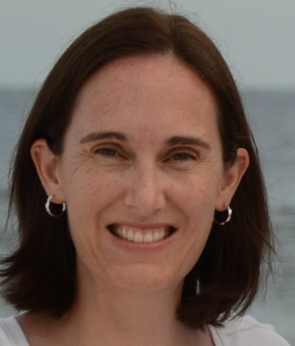
PD: Subtypes
Campbell MC et al, Ann Clin Transl Neuro 2020

Slide 8
PD: Subtypes
Campbell MC et al, Ann Clin Transl Neuro 2020

Slide 9
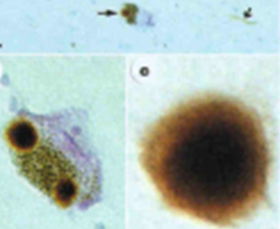
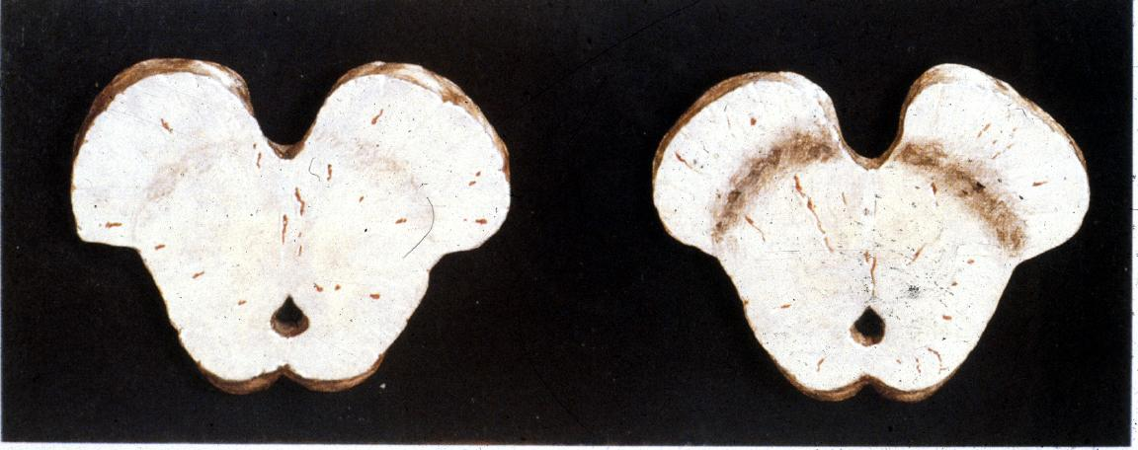
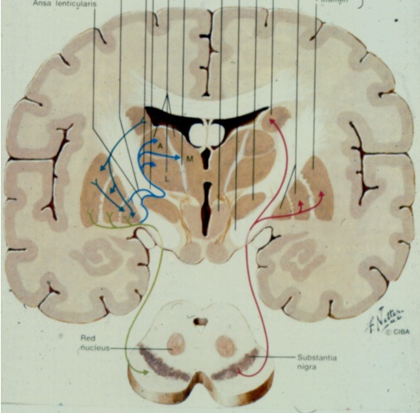
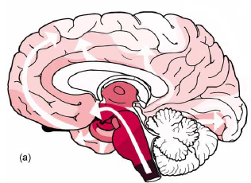
PD Pathology
Lewy body
Normal
PD
Braak, Neurobiol Aging 2004

Slide 10
Causes Cognitive of Impairment
Alpha-synuclein
Transmitter deficiencies
Network dysfunction
Neuroinflammation/free radicals

Slide 11
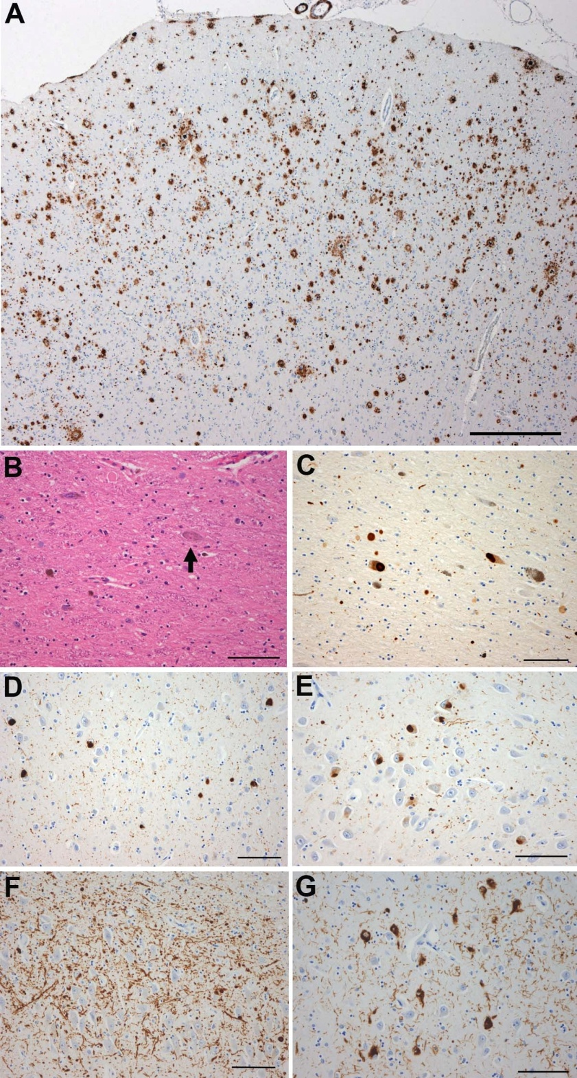
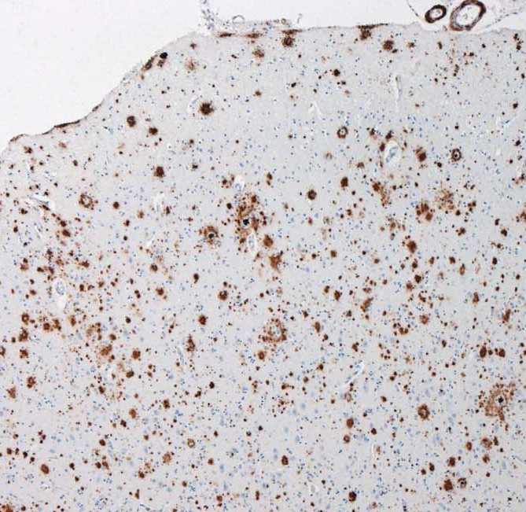
Dementia: Cortical Pathology
α-synuclein spread
Braak, Neurobiol Aging 2004
PD Alzheimer disease (75%)
A-beta
tau
α-synuclein
NFTs
Neuritic plaques
Neuritic tangles

Slide 12
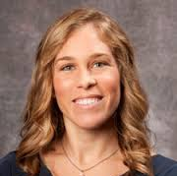
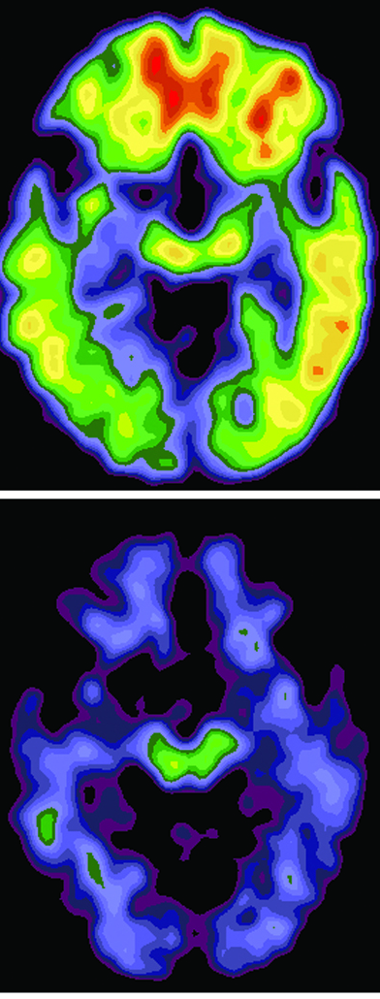
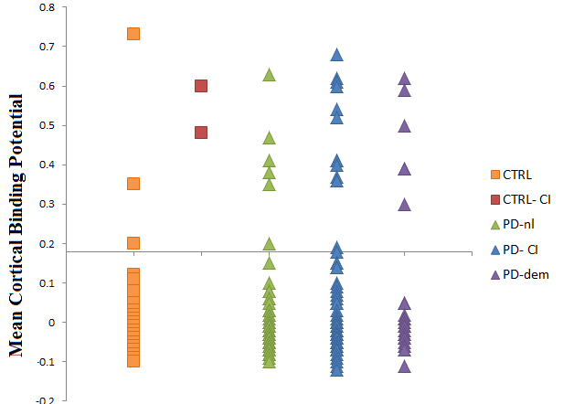
PiB PET: PD &
dementia
9% 20% 26%
PiB+
PiB -
N = 207
Campbell M et al, 2013; Foster E et al, 2010; Burack M et al, 2010

Slide 13

Dementia & PD
(n = 33)
α-synuclein only | α-synuclein & Aβ | α-synuclein & Aβ & Tau
12 | 20 | 1
Lewy pathology | Lewy & Aβ pathology | Lewy & Alzheimer’s
Kotzbauer P, et al, Arch Neurol, 2012

Slide 14
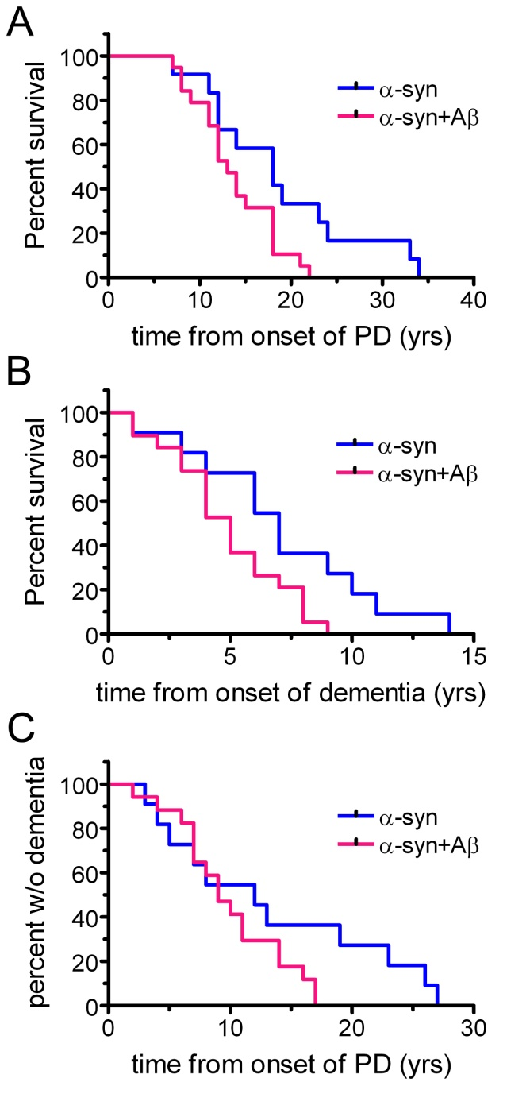
Survival Analyses
(n = 32)
P = .027
P = .038
Kotzbauer P et al, Arch Neurol 2012

Slide 15
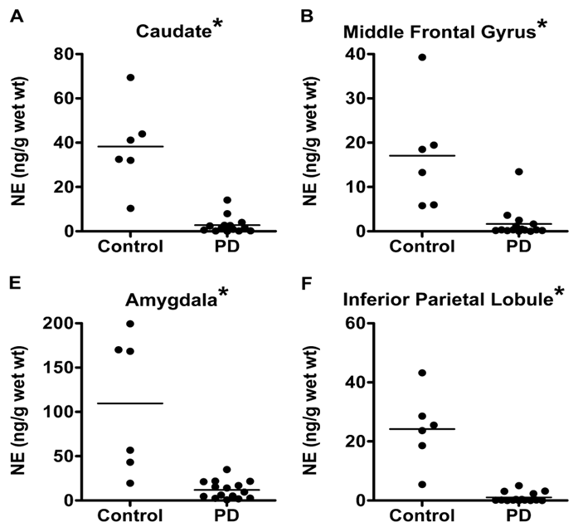
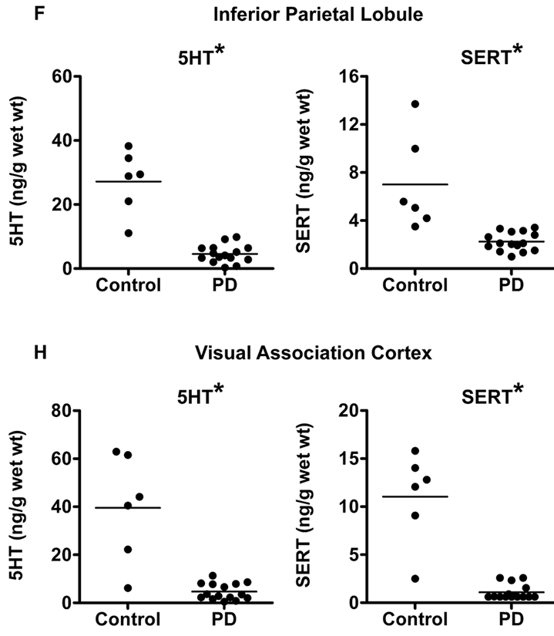
Norepinephrine & Serotonin
Buddhala C et al, Ann Clin Trans Neurol 2015

Slide 16
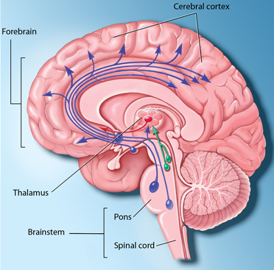

Pathways from Brainstem to Cortex
PD
Amish

Slide 17
[11C]MRB (Norepinephrine)
BPnd
PD
Amish
Hannestad J et al, Biol Psychiatr 2010

Slide 18
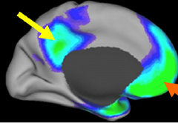
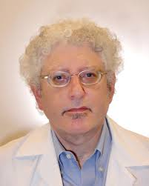
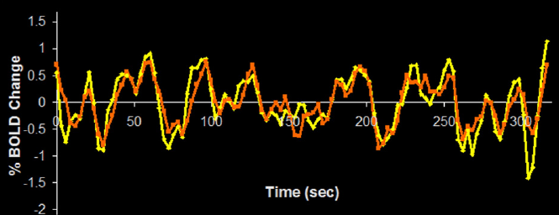
Resting-State Functional Connectivity
Fox MD et al, PNAS 2005
Raichle & Snyder, Neuroimage 2007

Slide 19
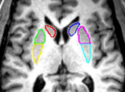
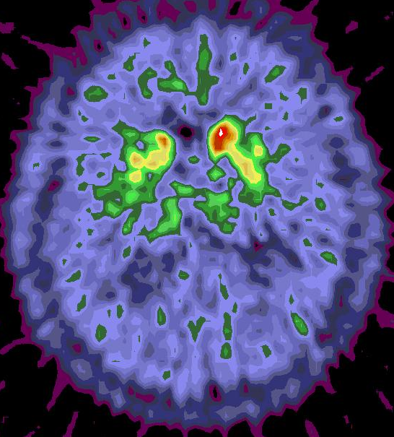
Seed Regions for rs-fcMRI
FD
PD
Hacker C et al, Brain, 2012
Notes:
1

Slide 20
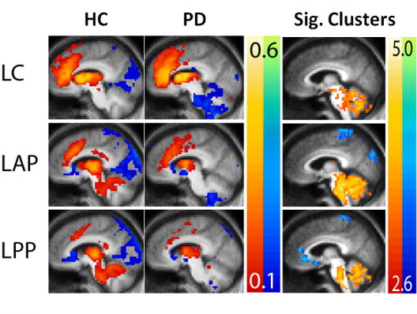
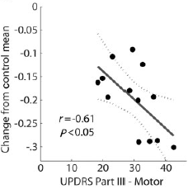
Resting-State Functional Connectivity
Hacker C et al, Brain 2012

Slide 21
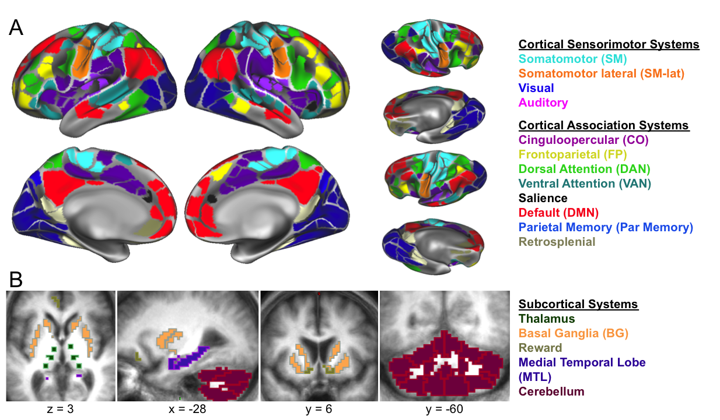
Reduced FC Relates to Cognitive Deficits
Non-demented PD (n=107) – OFF meds
HC are PIB- (n=46)
Gratton C et al., 2018. Cerebral Cortex
Maiti B et al, 2020, Neurology

Slide 22
Differences in FC (PD-HC)
FP
Gratton C et al., 2018. Cerebral Cortex

Slide 23
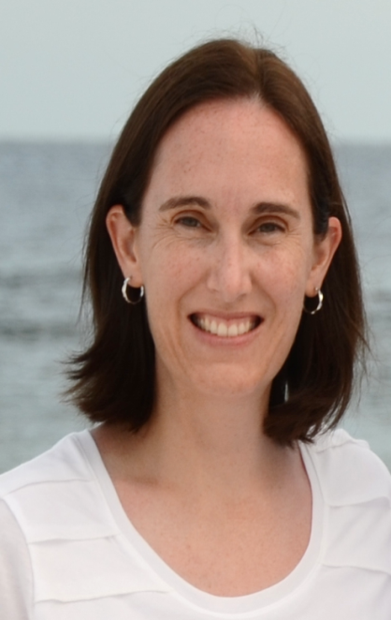
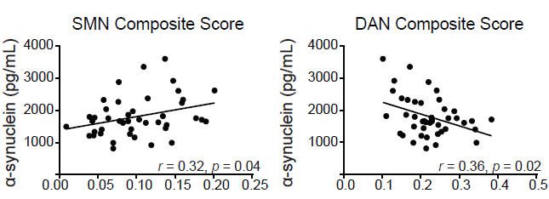
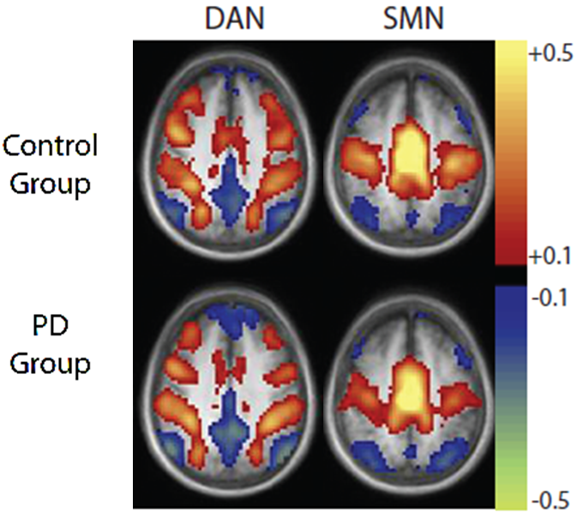
rs fcMR networks & CSF α-syn
PD
Campbell MC et al, Neurology 2015

Slide 24
DAN-FPCN FC Declines in PD
p = 0.015
Campbell MC et al., Neurology (2020)

Slide 25

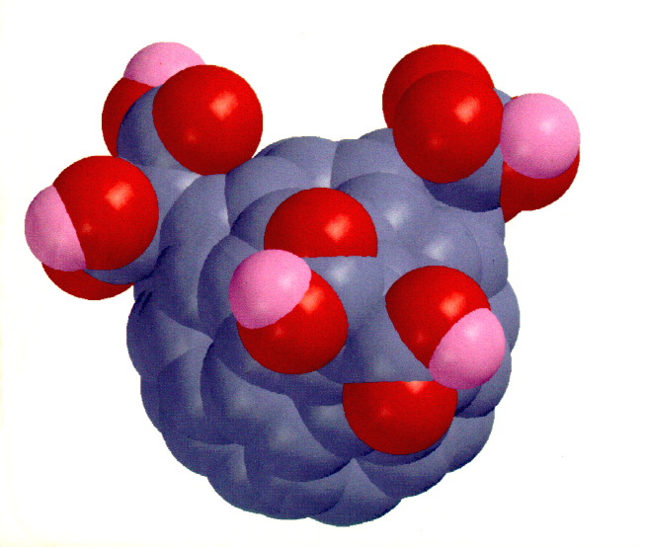

Carboxyfullerene (C3)
Dugan L et al, Ann Neurol, 2014

Slide 26
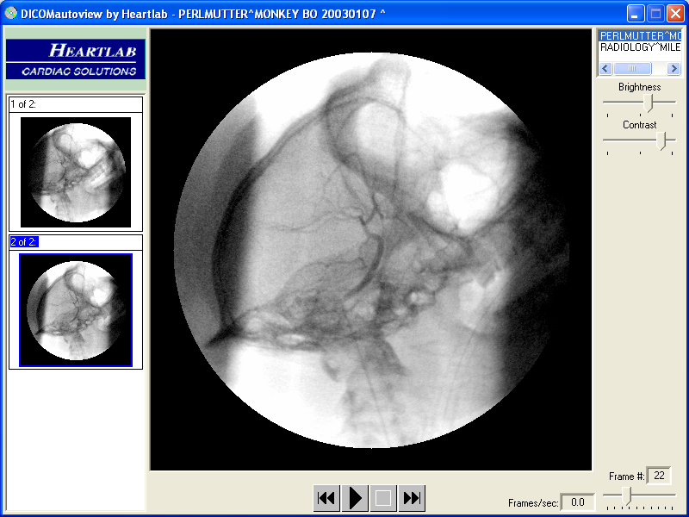
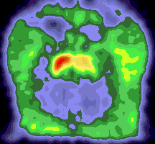
Carboxyfullerene Rescue
MPTP
Control
C₃
C₃
FD PET
MPTP
Dugan L et al, Ann Neurol, 2014
Notes:
Mean Parkinsonian Rating Scores graphed over time. At Day 0, all animals underwent unilateral intra-carotid injection of MPTP. Progression of symptoms over the next 5 days was similar for all animals (red line). At 8-10 days, animals were anesthetized, and pumps containing either C3, or color matched dilute food coloring in normal saline. Based on previous pharmacokinetic studies, therapeutic levels of C3 in brain were expected to be achieved 7-10 days after pump implantation (arrow). Neither the average ratings, or the slope of progression of ratings, did not differ during this initial period (orange lines). However, at approximately 14 days after pump implantation, symptom ratings and sloe of progression began to diverge (green lines). Pumps were replaced one month after the first set of pumps.

Slide 27
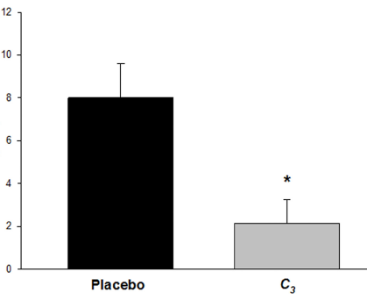
C3 Efficacy
FDOPA
PD motor ratings
DTBZ
Striatal
dopamine
Dugan L et al, Ann Neurol, 2014

Slide 28
Research Plan: goals
Validate Measures of C3 effects
Target Engagement!
Prepare for Human trial
MicroPET
scanner

Slide 29
Collaborators
Chris Brown
Chandana Buddhala
Nigel Cairns
Meghan Campbell
Laura Dugan
Caterina Gratton
Carl Hacker
Morvarid Karimi*
Paul Kotzbauer
B (Jay) Maiti
Steve Moerlein
Scott Norris
Rick Perrin
Josh Shimony
Avi Snyder
LinLin Tian
Tom Videen
Erin Foster Voegtli
Emily Flores
Hugh Flores
John Hood
Aixiao Li
Susan Loftin
Hannah White
Emily Williams
*deceased

